Slide 1
Recurrent Neural Network
AICTE-MARGDARSHAN sponsored workshop on Computational Intelligence for Multimedia
T. T. Mirnalinee
Prof/CSE
SSN College of Engineering
mirnalineett@ssn.edu.in

Slide 2
Introduction
Conventional feedforward neural networks can be used to approximate any spatially finite function
Functions which have a fixed input space there is always a way of encoding these functions as neural networks.
Recurrent neural networks are fundamentally different from feedforward architectures in the sense that they not only operate on an input space but also on an internal state space

Slide 3
Introduction
The state space enables the representation of temporally/sequentially extended dependencies
simple recurrent network, the input vector is similarly propagated through a weight layer, but also combined with the previous state activation through an additional recurrent weight layer, U

Slide 4
Simple Feed forward Network

Slide 5
Simple Recurrent Network

Slide 6
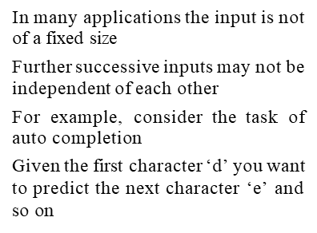
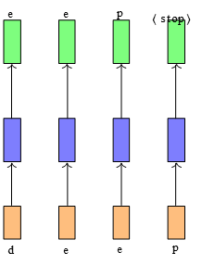
Sequence to Sequence Learning

Slide 7
Sequence to Sequence Learning
Successive inputs are no longer independent
The length of the inputs and the number of predictions you need to make is not fixed (for example, “learn”, “deep”, “machine” have different number of characters)
Each network (input : character output : character)

Slide 8
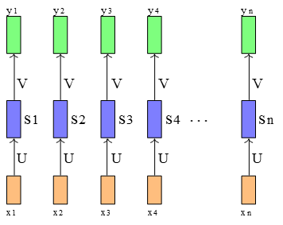

Slide 9
Sequence Problems
Tagging a sentence
Sentiment Analysis
Image captioning
Video Captioning
Speech processing

Slide 10
Dependence between inputs
Variable number of inputs
Function executed at each time step is the same

Slide 11
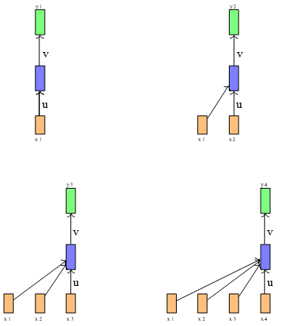
First, the function being computed at each time-step now is different
y1 = f1(x1)
y2 = f2(x1,x2)
y3 = f3(x1,x2,x3)
The network is now sensitive to the length of the sequence
For example a sequence of length 10 will require f1,...,f10 whereas a sequence of length 100 will require f1,...,f100

Slide 12
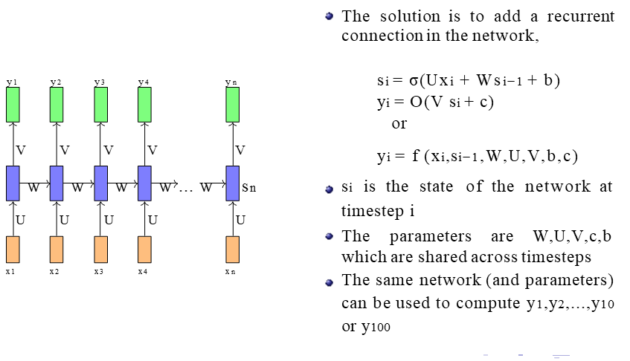
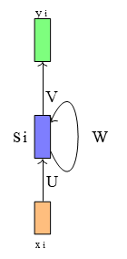

Slide 13
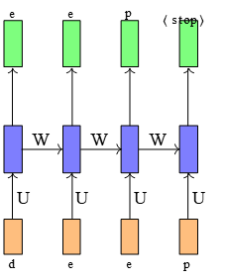
Suppose we consider the task of autocompletion (predicting the next character)
For simplicity we assume that there are only 4 characters in our vocabulary (d,e,p, <stop>)
At each timestep we want to predict one of these 4 characters

Slide 14
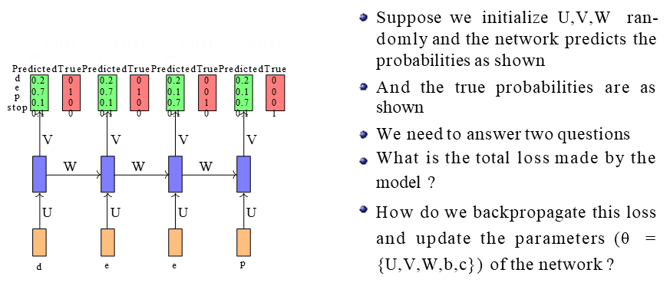

Slide 15
Before proceeding let us look at the dimensions of the parameters care- fully
(n-dimensional input)
d
(d-dimensional state)
k
(say k classes)
U ∈ Rn×d V ∈ Rd×k
W ∈ Rd×d
y1
V
W
U
x1
y2
V
W
U
x2
y2
V
W
U
x2
y2
V
W
U
x2
xi ∈ R
si ∈ R
yi ∈ R
. . . . . . . . . . . . . . . . . . . .
. . . . . . . . . . . . . . . . . . . . 22/1

Slide 16
Let us consider the derivative
∂L (θ)
∂W
L1(θ) L3(θ) L4(θ)
T
∂L (θ) ∂Lt(θ)
=
∂W ∂W
t=1
By the chain rule of derivatives we
y1 y3 y4
PredictedTruePredictedTrue PredictedTruePredictedTrue
d 0.2 0 0 0.2 0 0.2 0
e 0.7 1 1 0.1 0 0.1 0
p
0.1 0 0 0.7 1 0.7 1
stop 0.1 0 0 0.1 0 0.1 0
∑
V
V
V
know that ∂Lt(θ) is obtained by sum-
∂W
ming gradients along all the paths from Lt(θ) to W
W
W
W
U U U U
d e e e
. . . . . . . . . . . . . . . . . . . .
. . . . . . . . . . . . . . . . . . . . 28/1
Mitesh M. Khapra Sequence Learning Problems, Recurrent Neural Networks, Encoder Decoder

Slide 17

Recall that
L1(θ) L2(θ) L3(θ) L4(θ)
s4 = σ(Ws3 + b)
In such an ordered network, we can’t compute ∂s4 by simply treating s3 as
∂W
a constant (because it also depends on W )
In such networks the total derivative
∂s4 has two parts ∂W
V
s1
U
x1
V
s2
U
x2
V
s3
U
x2
V
s4
U
x2
W
W
W
W
...
Explicit :
∂+s4
∂W
, treating all other in-
s0
s1
s2
s3
s4
L4(θ)
puts as constant
Implicit : Summing over all indirect paths from s4 to W
W
. . . . . . . . . . . . . . . . . . . .
. . . . . . . . . . . . . . . . . . . . 31/1

Slide 18
∂s4 ∂W
∂s4 ∂W
+ ∂s4
∂s3
∂s3 ∂W
=
explicit implicit
[
]
= ∂s4
∂W
+ ∂s4
∂s3
∂s3 ∂W
explicit
+ ∂s3 ∂s2
∂s2 ∂W
implicit
∂s3
∂W
[
]
= ∂s4
∂W
+ ∂s4
∂s3
+ ∂s4
∂s3
∂s3
∂s2
∂s2
∂W
+ ∂s2
∂s1
∂s1
∂W
∂s3 ∂W
∂s2 ∂W
[
]
= ∂s4
∂W
+ ∂s4
∂s3
+ ∂s4
∂s3
∂s3 ∂s2
+ ∂s4
∂s3
∂s3 ∂s2
∂s2 ∂s1
∂s1 ∂W
4
k=1 . . .
. . .
∂s4 ∂W
∂s4 ∂W
∂s3 ∂W
∂s2 ∂W
∂s1 ∂W
. . . . .
∑
∂s4
∂sk . . . .
. . . .
∂sk ∂W
. . . . . . . .
= ∂s4
∂s4
+ ∂s4
∂s3
+ ∂s4
∂s2
+ ∂s4
∂s1
=
. . . .
.
.
.
.
.
.
.
.
.

Slide 19
L1(θ)
V
s1 W
U
x1
L2(θ)
V
s2 W
U
x2
L3(θ)
V
s3 W
U
x2
L4(θ)
V
s4 W
U
x2
∂L4(θ)
∂W
∂s4 ∂W
∴ ∂Lt(θ)
∂W
∂s4 ∂W ∂+sk ∂W
t
∂st
∂sk k=1
= ∂L4(θ)
∂s4
4
∂s4
=
∂sk k=1
= ∂Lt(θ)
∂st
∑
...
∑
∂+sk ∂W
s0
s1
s2
s3
W
s4
L4(θ)
This algorithm is called backpropaga- tion through time (BPTT) as we backpropagate over all previous time steps
. . . . . . . . . . . . . . . . . . . .
. . . . . . . . . . . . . . . . . . . . 33/1
Mitesh M. Khapra Sequence Learning Problems, Recurrent Neural Networks, Encoder

Slide 20
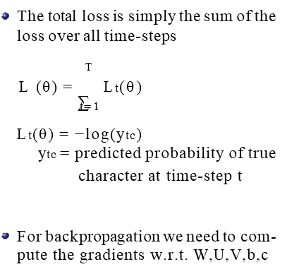

Slide 21
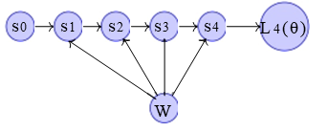
L4(θ) depends on s4
s4 in turn depends on s3 and W s3 in turn depends on s2 and W s2 in turn depends on s1 and W s1 in turn depends on s0 and W

Slide 22
Learning by Back propagation

Slide 23
Simple recurrent network
A simple recurrent network has activation feedback which embodies
short-term memory. A state layer is updated not only with the external input of the network but also with activation from the previous forward propagation. The feedback is modified by a set of weights as to enable automatic adaptation through learning

Slide 24
Various forms of RNN

Slide 25
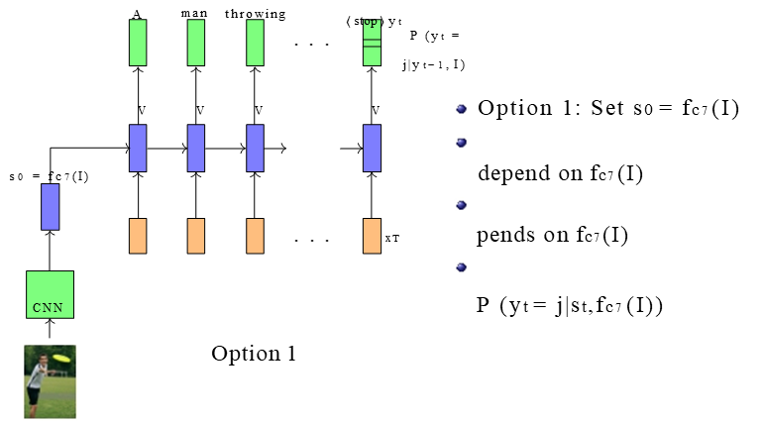
Image Captioning

Slide 26
Vanishing Gradient
RNN suffers from vanishing gradient problem
What happens to the magnitude of the gradients as we backpropagate through many layers?
If the weights are small, the gradients shrink exponentially.
If the weights are big the gradients grow exponentially.

Slide 27
In an RNN trained on long sequences (e.g. 100 time steps) the gradients can easily explode or vanish.
We can avoid this by initializing the weights very carefully.
Even with good initial weights, its very hard to detect that the current target output depends on an input from many time-steps ago.
So RNNs have difficulty dealing with long-range dependencies
Solution LSTM
Selectively read
Selectively write
Selectively forget

Slide 28
Summary
RNNs allow a lot of flexibility in architecture design
Vanilla RNNs are simple but don’t work very well
Common to use LSTM or GRU
improve gradient flow
Backward flow of gradients in RNN can explode or vanish.
Exploding is controlled with gradient clipping. Vanishing is
controlled with additive interactions (LSTM)
Better/simpler architectures are a hot topic of current research

